Slide 1


WasteSense:
Efficient Waste Management for Cities
Introducing WasteSense, a revolutionary solution that empowers cities to manage waste efficiently, engage citizens, and enhance urban sustainability.
by Chackochan Sebastian

Slide 2
Problem Statement
Overfilled bins
Inadequate segregation at source
Lack of real-time data
Inefficient/ delayed garbage collection
Environmental pollution from overflowing waste

Slide 3
WasteSense: A Smart Solution for Cities
Key Features
Benefits
Smart bin monitoring (real-time fill levels) using IoT
Enhanced citizen engagement (user-friendly app)
AI based waste segregation tips
Real-time updates on schedules & issue reporting
Efficient routing
Reduced overflows
Improved garbage collection schedules
Automated alerts
Services for bulk waste collection

Slide 4
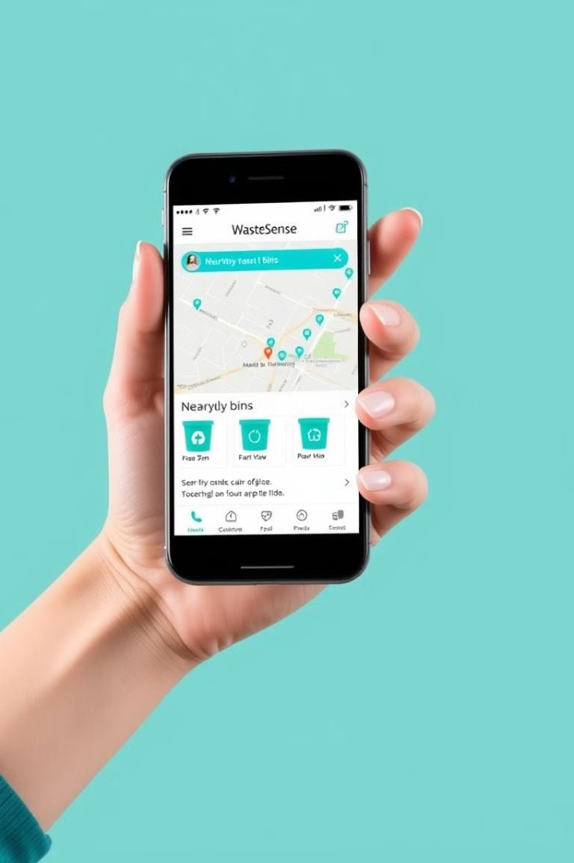
Empowering Users with WasteSense
Get Educational Content
View Nearby Bins
Real-time status updates
Waste segregation guide
Receive Notifications
Report Issues
Submit complaints and request for new bins
Collection schedules
Support for Bulk Waste Collection
Schedule premium services for large amounts of waste

Slide 5
Admin Dashboard: Managing Waste Efficiently
Bin Management
Create Schedules
Complaint Handling
Automated Alerts
View real-time bin locations, fill levels, and statuses.
Optimize collection routes based on bin fill levels and traffic.
Review and respond to citizen complaints via the integrated system.
Receive notifications on critical events (overflowing bins, new bin requests).
Manage bin details
System and email alerts.

Slide 6
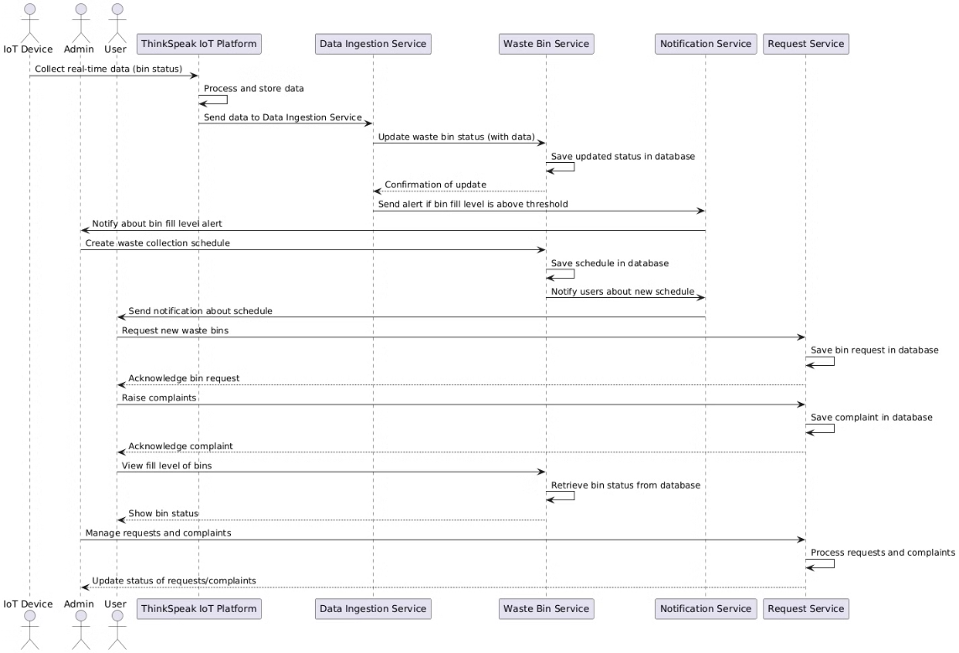
Process Flow

Slide 7
Technical Architecture
Backend
Frontend
IoT Integration
Spring Boot microservices for modularity and scalability.
Angular for user-friendly, responsive interface across devices.
Secure platform for real-time data ingestion from smart bins.
Map Visualization
AI Waste Segregation
OpenStreetMap API for geolocation and interactive map features.
Google Gemini API for AI-powered waste sorting tips.

Slide 8
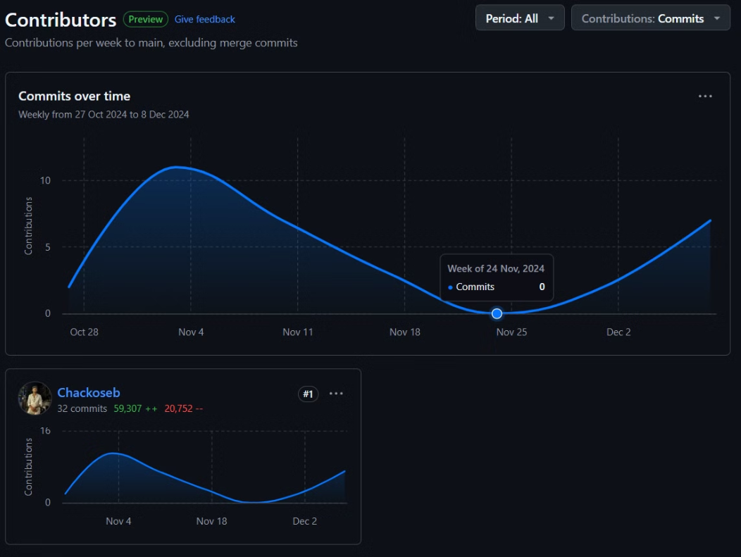
GitHub Analytics

Slide 9
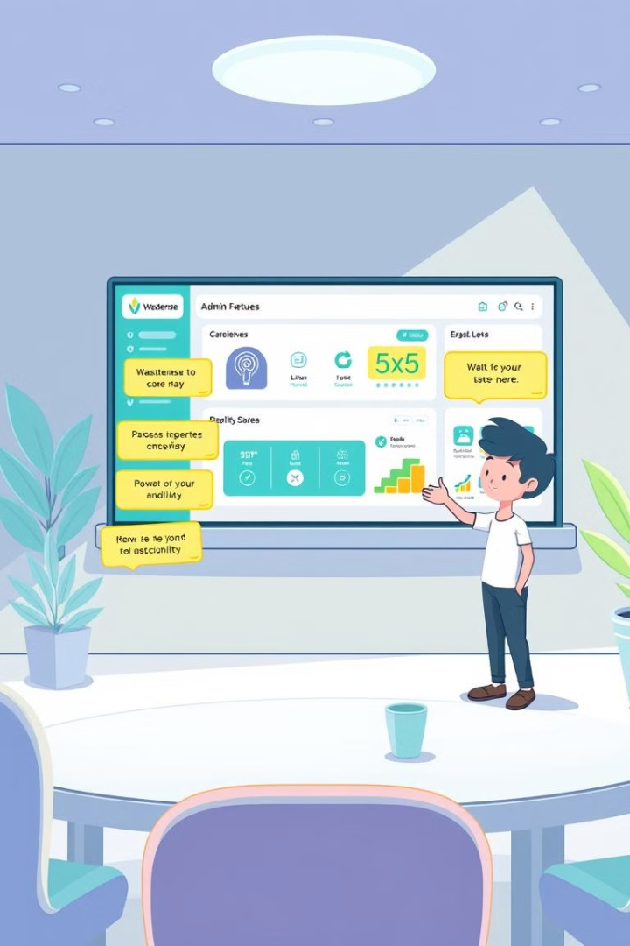


WasteSense: Demo and Next Steps
User Walkthrough
Registration, bin monitoring, reporting
Admin Walkthrough
Dashboard overview, schedule management, analytics

Slide 10

WasteSense: A Cleaner Future
Together, let's build a more sustainable tomorrow.

